Slide 1
R Shiny Web Application for RedCap
By: Abubaker Mohamed, Michael Lau, Kyuhwan Kim

Slide 2



Recap...
Used RedCap to design a data template based on the PIDTC 6903: CGD Prospective Cohort Day 100 HCT Post Treatment Status and Events Worksheet.
Template exported from RedCap to Excel. With its functions, to randomly generate valid values to create 500 surrogate samples.
Used RShiny to customize a design to create a user-friendly program to visualize the big data in table and graph forms.

Slide 3
Prototype
Demonstrated 3 weeks ago with very early rudimentary prototype:
Crude design: a simple output of data table meant lack of organization and difficulty in finding relevant data
Unusual column names: Output of names were in computer function format and was not intuitive towards the end user.
Unusual values: Sections that have "Yes, No, Unknown" were outputted as "0,1,2"

Slide 4
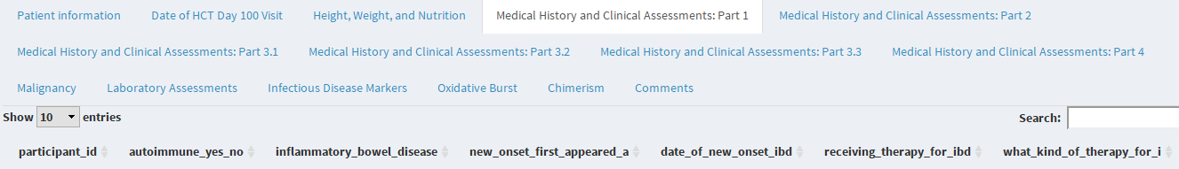
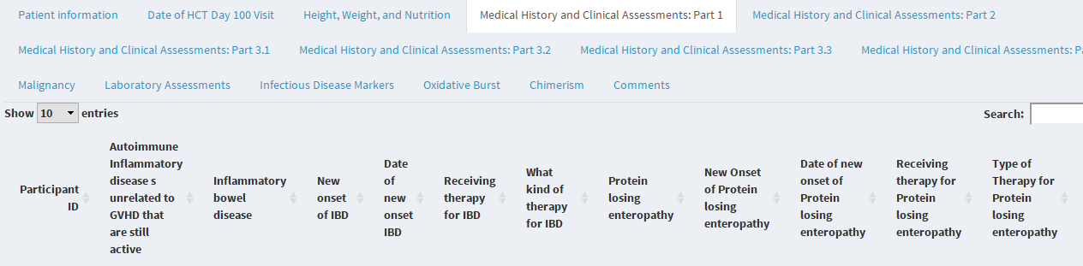
Before
After

Slide 5
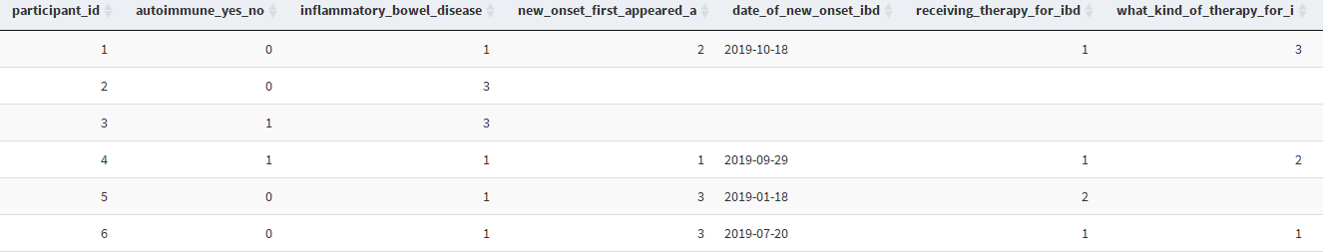
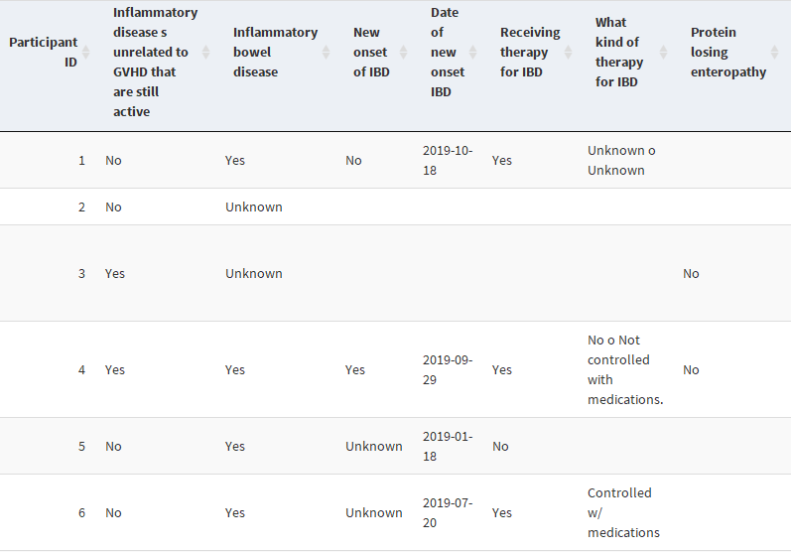
Before
After

Slide 6
Current Build
Sidebar: enables organizations
Used tablature formatting to further organize the data
Tables and Charts
Ability to sort (ascending/descending)
Search function
Help and Additional Info Section
Better Graphical User Interface
Easy Click!

Slide 7
Demonstration
We will now demonstrate the program.
Necessary files/programs:
RStudio (with some library packages)
RedCap exported Labels file
RedCap exported Raw file
Custom headers file

